Slide 1
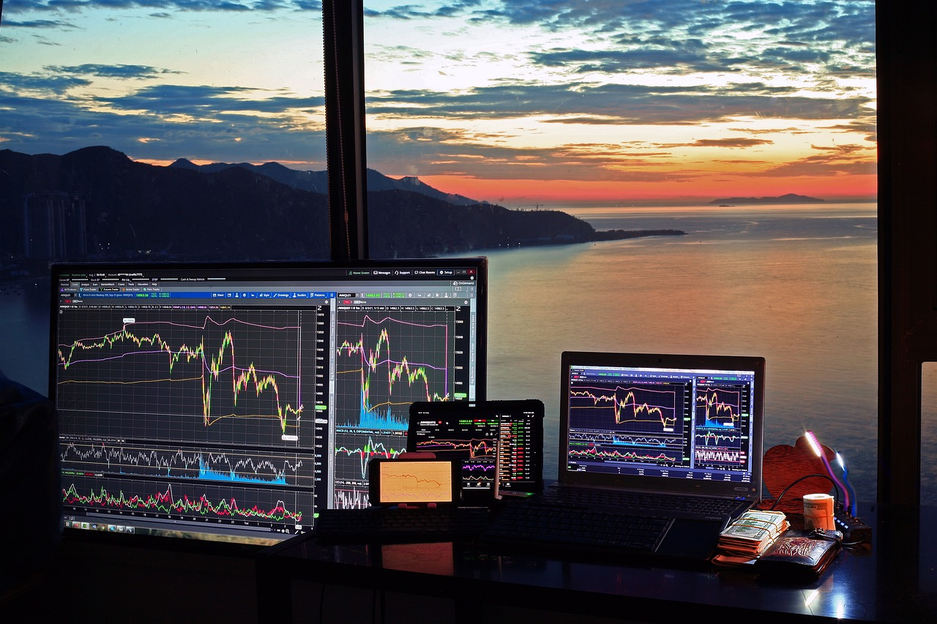
STOCK PORTFOLIO ANALYSIS
Team Members
Abhishek Kumar Singh
Karishma Darla
Nithyashree Bandihalli Rangaswamy
Sanjay Sandhosh

Slide 2
INTRODUCTION
Stock:
A stock represents ownership in a company and typically entitles the holder to a portion of the company's assets and profits.
Portfolio:
A portfolio is a collection of financial assets such as stocks, bonds, and other investments held by an individual or entity.
Portfolio analysis:
Portfolio analysis involves evaluating the composition, performance, and risk characteristics of a portfolio to make informed investment decisions.
CAPM (Capital Asset Pricing Model):
CAPM is a financial model that describes the relationship between expected return and risk for individual securities, helping investors determine the expected return on an investment given its risk.

Slide 3
STEPS TAKEN
1. Data Extraction
2. Data Preparation
3. Descriptive Analysis & Profiling
4. Cumulative Performance Calculation
5. Portfolio Creation & Analysis
6. Dealing With Alpha & Beta
7. Sharpe Ratio Calculation
8. Conclusions

Slide 4
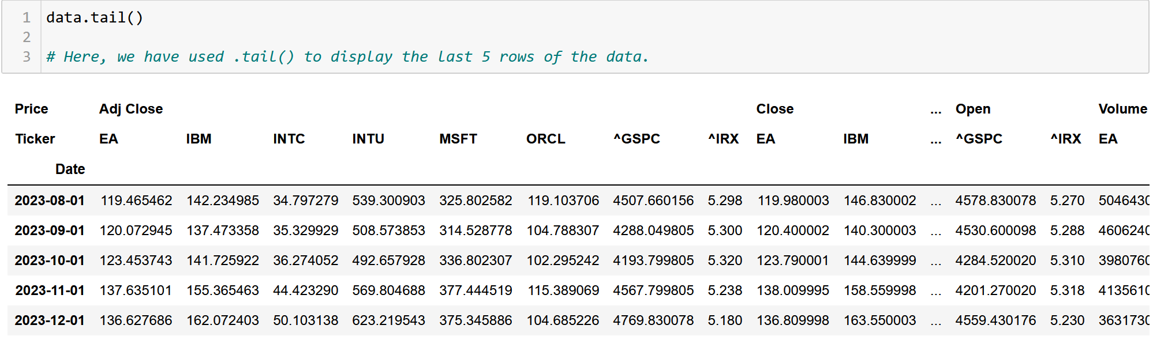
DATA EXTRACTION & PREPARATION
Data Collection:
Extracted stock data from Yahoo Finance.
Company Selection:
Chose: Microsoft, Intel, Electronic Arts, IBM, Intuit, and Oracle, S&P 500 and T-Bill.
Data Cleaning:
Performed data cleaning by selecting top-level index & checked missing Values.
Data Processing:
Calculated Monthly returns & Visualized.

Slide 5
DESCRIPTIVE ANALYSIS & PROFILING
To understanding the data, we used various functions:
isnull().sum() : for finding NULL values
.describe() : for looking at the statistical data such as mean, mode etc.
Created correlation heatmap of the data, visualizing the correlations between all the company stocks, S&P500 and Treasury Bills.

Slide 6
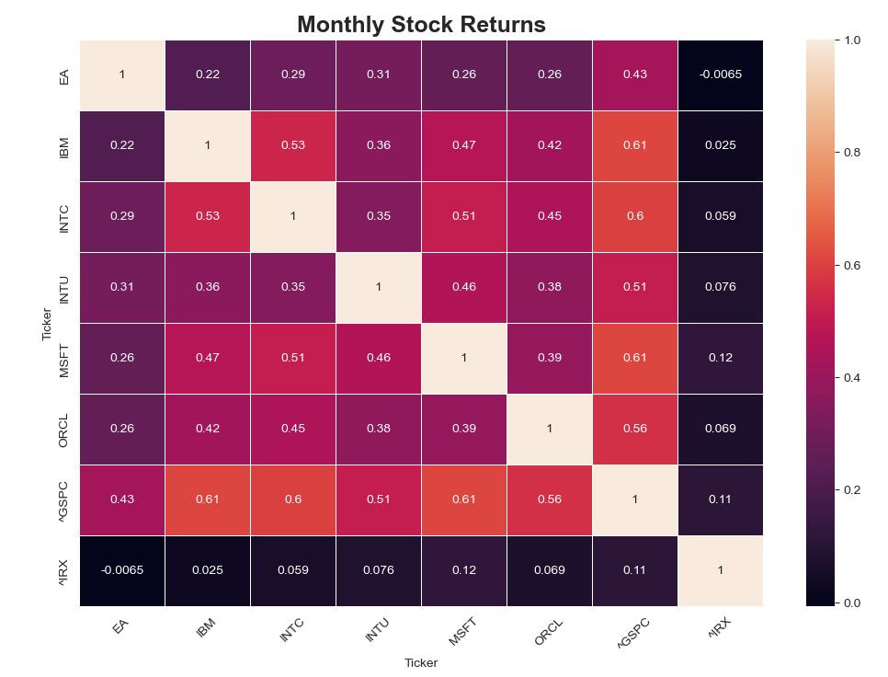
Correlation Matrix:
Notes:
COrrealtion doesn't mean CAusation.
Point to be noted : IRX == risk free rate

Slide 7
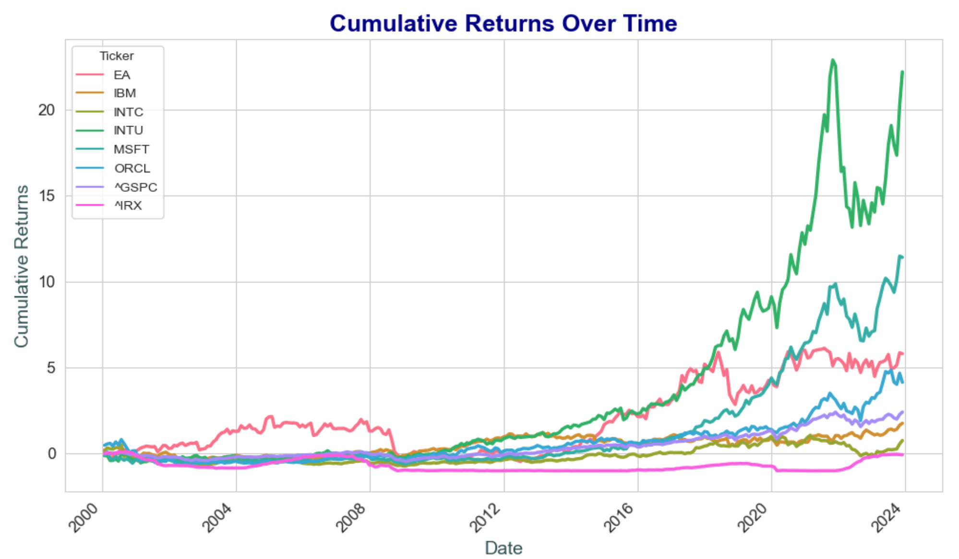
CUMULATIVE PERFORMANCE CALCULATION
Transformed the data from monthly adjusted closing price to monthly returns by using the .pct_change() method.
This process allows us to analyze the relative price movements of stocks over time, providing insights into their performance dynamics and facilitating comparative analysis.
Notes:
The stocks or portfolios exhibit distinct performance patterns, with some (like MSFT and INTU) showing consistent growth, while others (like EA and INTU) experience more volatility or periods of stagnation.
3) Towards the later part of the time period, a few stocks (notably INTC and IBM) have significantly underperformed than the market.
4) We can also see that the years 2008-2009 (after the recession) seems to be a point of inflection where the returns on stocks seems to have consistently performed better.

Slide 8

PORTFOLIO CREATION & ANALYSIS
Constructed a portfolio from the software sector : 1 share of EA, 2 shares of IBM, 3 shares of INTC, 1 share of MSFT & 2 shares of ORCL.
Estimated CAPM parameters to gauge risk-adjusted performance and expected returns.
MER & SER (Market & Stock Excess Return) are used to create CAPM models using smf.ols() function. From statsmodel library.
Rs−Rf=α+β(Rm−Rf)+ε
Notes:
LHS = SER, Rm-Rf = MER

Slide 9
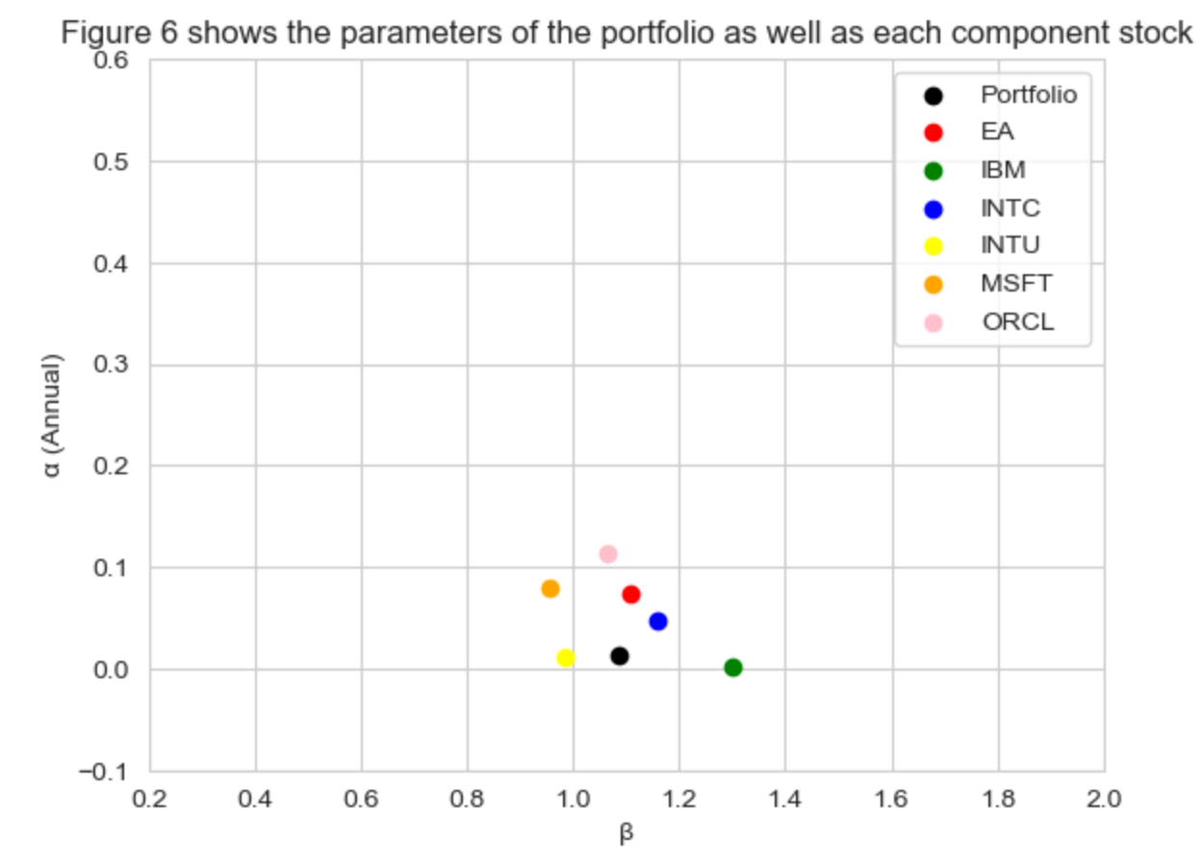
This graph clearly shows that our portfolio is the less volatile than its components. Although, we chose stocks from just one sector, our portfolio is diverse enough to generate non-volatile results.

Slide 10

DEALING WITH ALPHA & BETA
Assessed alpha and beta to evaluate the performance and risk exposure of individual stocks and the portfolio.
Calculated annualized alpha and beta coefficients for each stock and the portfolio using the CAPM model.
Tested for the significance of alpha to determine if stocks outperform or underperform the market.
Analyzed changes in alpha and beta over time through rolling window analysis, providing insights into evolving risk-return dynamics.
Notes:
1. For calculating alpha and beta values, we used the ols() function from the statsmodel library which is an ordinary LS Linear Reg and fitted the stocks data with the expected market premium
2. The rolling period used in this project is for a 5 year window, for example …….

Slide 11
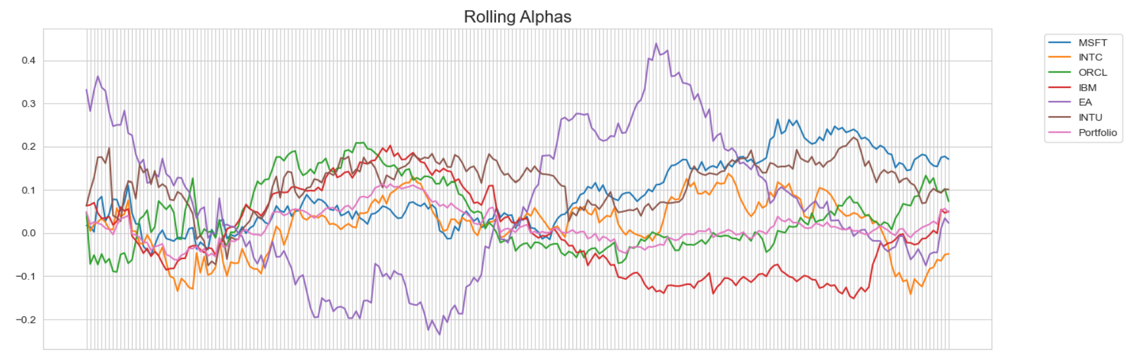

Slide 12
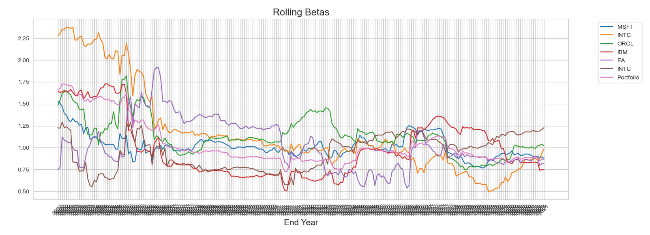



Slide 13

SHARPE RATIO CALCULATION
Evaluates the risk-adjusted return of the portfolio and individual stocks over the past 5 years.
Computed Sharpe ratios for each stock and the portfolio using recent 5 years of monthly data.
Sharpe ratio quantifies the excess return earned per unit of volatility or risk, providing insights into the performance efficiency of investments.
Results:
- MSFT: 1.356
- INTC: 0.2855
- ORCL: 0.8184
- IBM: 0.6549
- EA: 0.5863
- INTU: 0.9734
- Portfolio: 0.91788
- GSPC: 0.7892
Notes:
Highest Sharpe Ratio:
MSFT has the highest Sharpe Ratio among the provided assets, indicating it delivered the highest return relative to its risk.
Companies Outperforming the Market:
MSFT, ORCL, INTU, and Portfolio all have Sharpe Ratios exceeding the market Sharpe Ratio, signifying they generated better risk-adjusted returns than the broader market.
Portfolio Performance:
The portfolio Sharpe Ratio outperforms the market Sharpe Ratio, implying it delivered a superior risk-adjusted return compared to the overall market.

Slide 14

CONCLUSION
The portfolio has a positive alpha, indicating it generates excess returns above the market.
The portfolio's beta is close to 1, suggesting it has similar volatility to the market.
The portfolio's Sharpe ratio is higher than the S&P 500, indicating better risk-adjusted returns.
Diversification has helped reduce the portfolio's volatility compared to individual stocks like INTU.

Slide 15


